Slide 1
AirBnB Investment Project 1

Slide 2




Promote & Sub_promote
Analytics & Results
Recommendation
Outlines

Slide 3
Promote & Sub_promote
Should our investor invest in an Airbnb hotel in Washington, D.C.? If so, in which neighborhood should they invest?

Slide 4

Analytics & Charts

Slide 5
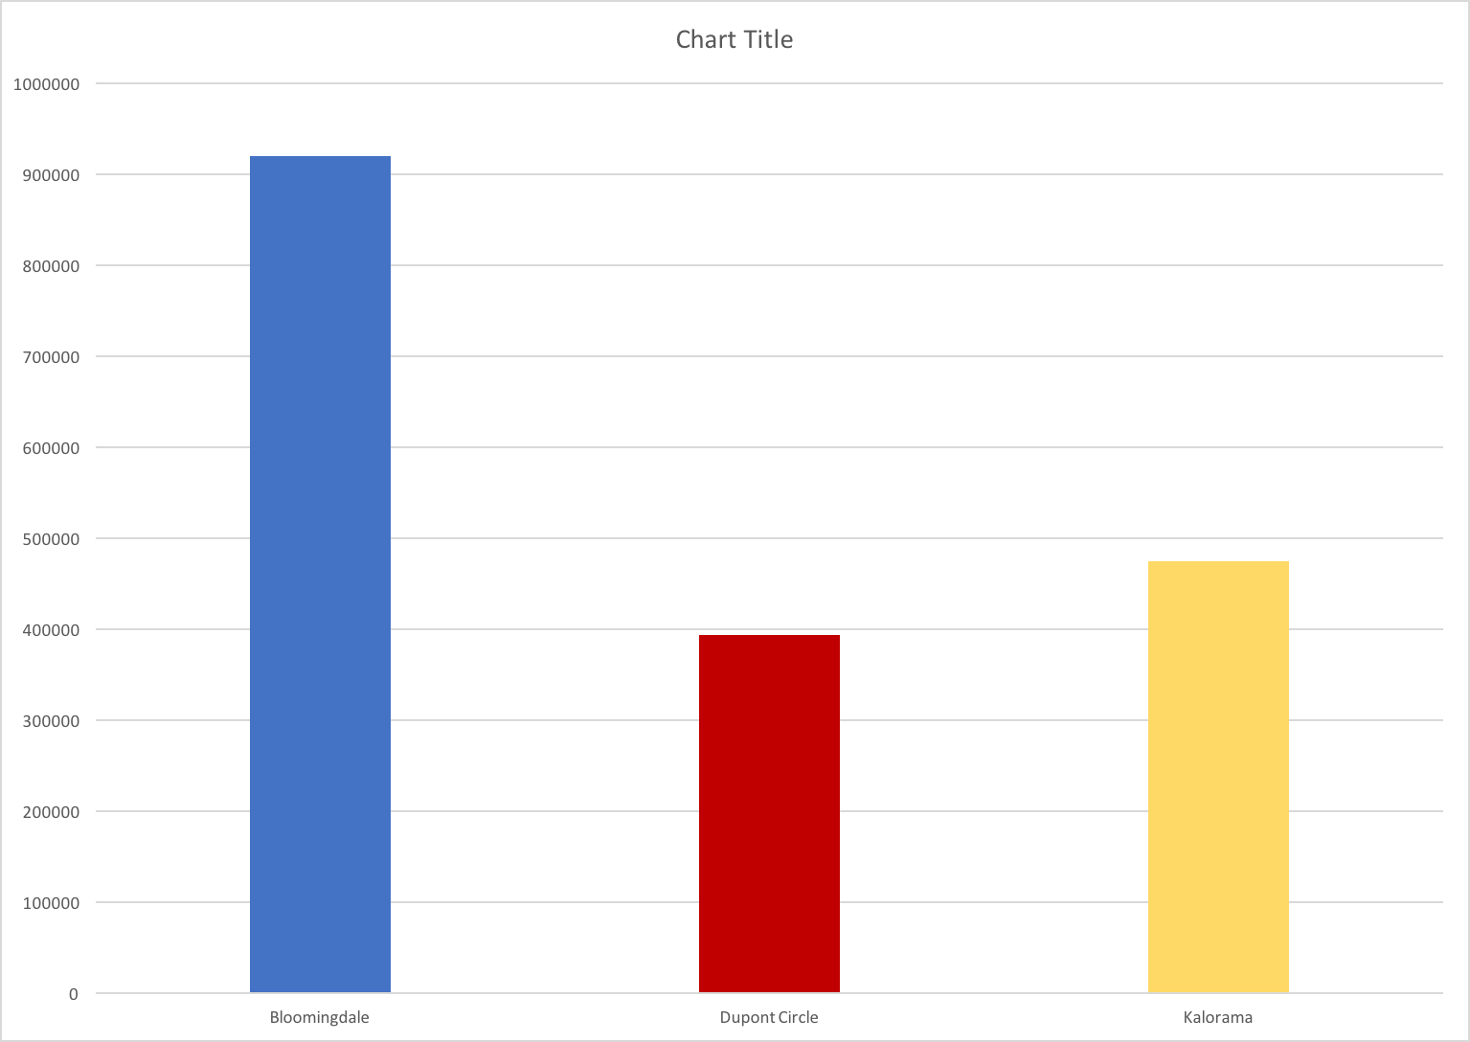
Top 3 neighborhood by revenue

Slide 6
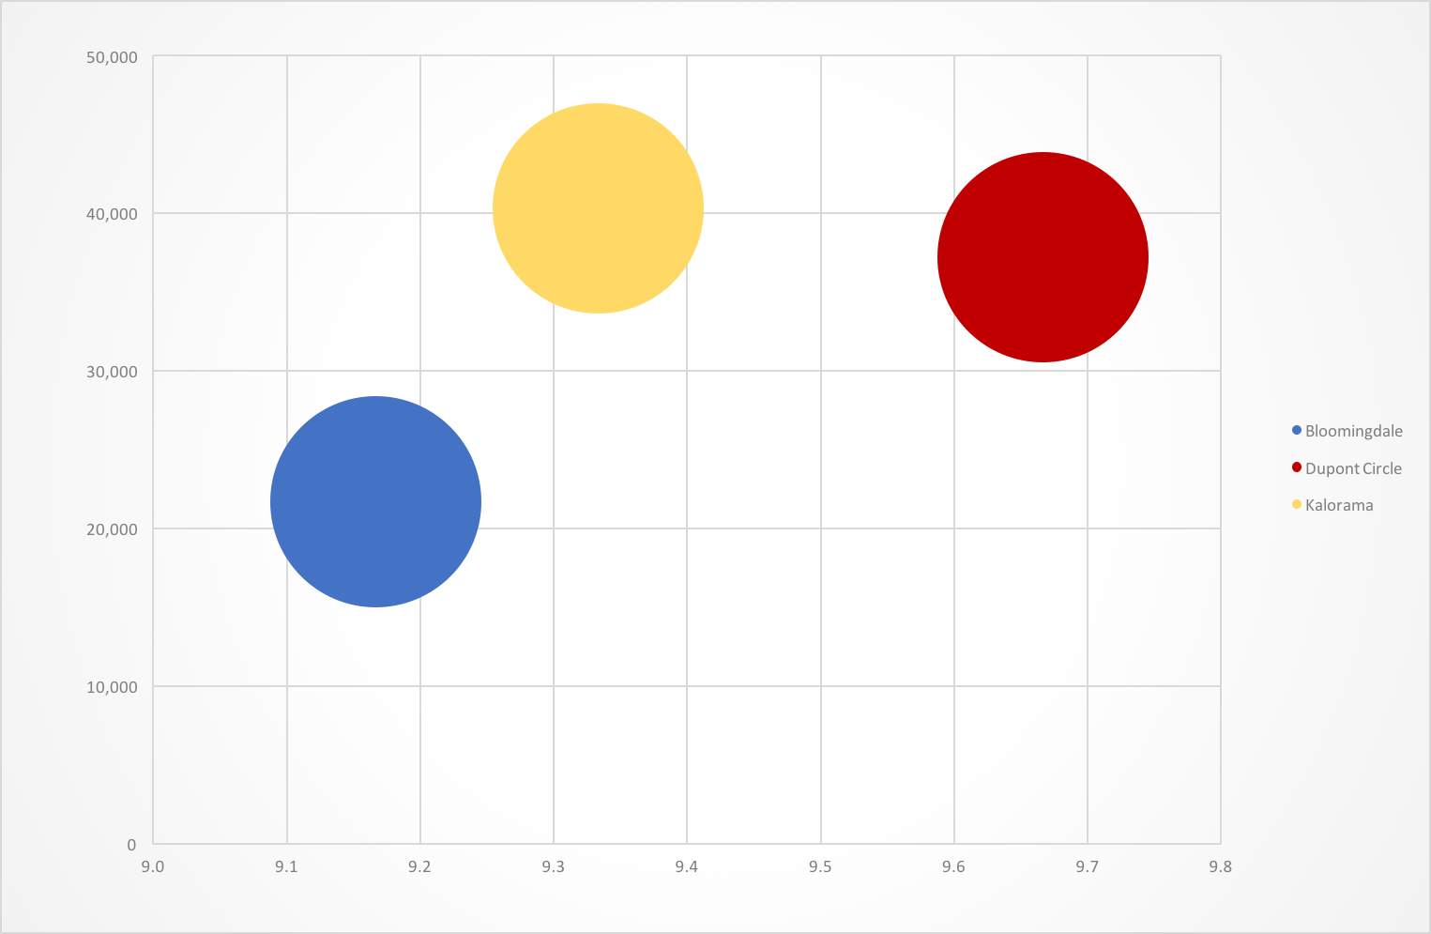
Potential revenue for next year

Slide 8
Recommendations
Instead of the revenues , Rates , and Potential revenues The best choice to invest on is :
Kalorama neighborhood

Slide 9


Thank You
01
Notes:
You can safely remove this slide. This slide design was provided by SlideModel.com – You can download more templates, shapes and elements for PowerPoint from http://slidemodel.com/

